Slide 1
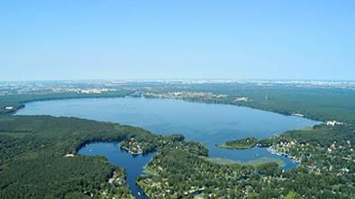
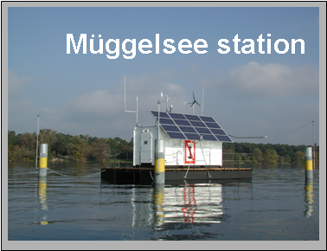
Online Seminar zum Weltwassertag 2021
Gewässer, Seen und Feuchtgebiete im Klimastress –
Forschung und Fallstudien
Picture 1
Müggelsee
Seen im Klimawandel
Picture 2
Rita Adrian
Department of Ecosystem Research

Slide 2
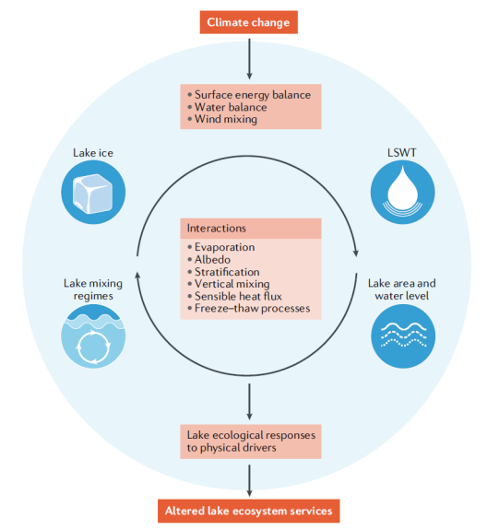
Lakes in a changing climate
Erhöhte
Wasser-
Temperaturen
Verlust von Eis
Veränderung
Thermisches
Regime
Ökologie
Woolway et al. 2020
Dienstleistungen
Notes:
Essential lake variables, their responses to CC and how they interact with one another.
Decreasing ice, rising WT and altered lake mixing will influence evaporation rates- with subsequent changes in water levels and extent
Climate induced changes in these key physical variables will influence lake productivity and consequerntly ES
Put those changes in the context of ecosystem resistance and resilience
Are there clear irreversable regime shifts ? Lake physics cannot be resilient in the long term…..

Slide 3
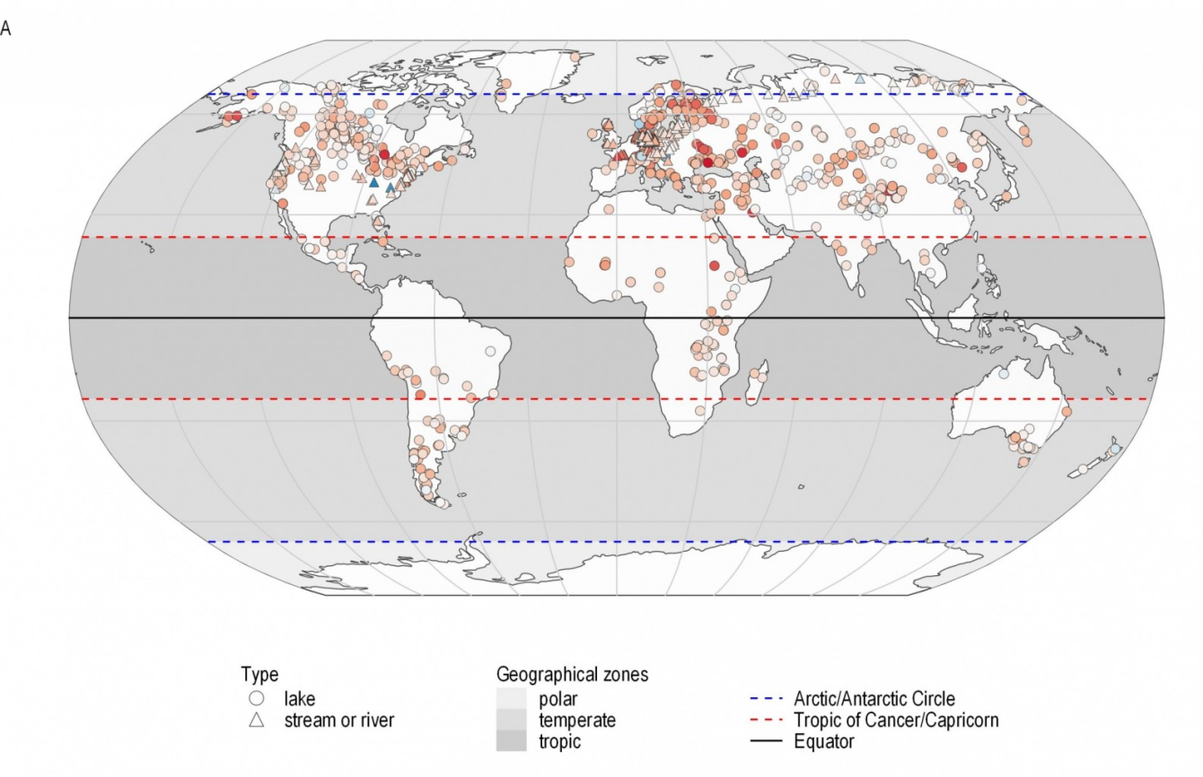
Global lake surface water temperature trends
0.34°C / Decade: 1985 - 2009
Data source: O‘Reilly et al. 2015, Woolway et al. 2020

Slide 4
Global versus local lake surface water temperature trends
Global:
0.34°C / decade
(1985 – 2009)
°C
Data source: O‘Reilly et al. 2015, Woolway et al. 2020
Local:
0.6°C /decade
(1978-2020)

Slide 5
Projected lake mixing regime shifts
1985-2005 / 2080-2100
Woolway et al. 2020
Müggelsee_ #days when stratified
Notes:
Clear regime shifts- which are – however – reversable- if climate changes again
Lake mixing regime changes due to projected twenty first century climate change
A: simulated chnges in lake mixing regimes between 1985-2005 and 2080-2100
B: projections using a lake model forced with low RCP 2.6 greenhouse gas concentration scenario
C: projections using a lake model forced with low RCP 2.6 greenhouse gas concentration scenario
A wide spread decrease in winter ice cover and an increase in LSWT will modify lake mixing regimes , typically shifting lakes to the right along the polymictic-dimictic-monomictic- oligomictic- meromictic continuum.
As lakes mix less frequently in response to climate change, some of the most common anticipated mixing regime changes include a shift from dimictic to monomictic and from monomictitic to meromictic

Slide 6
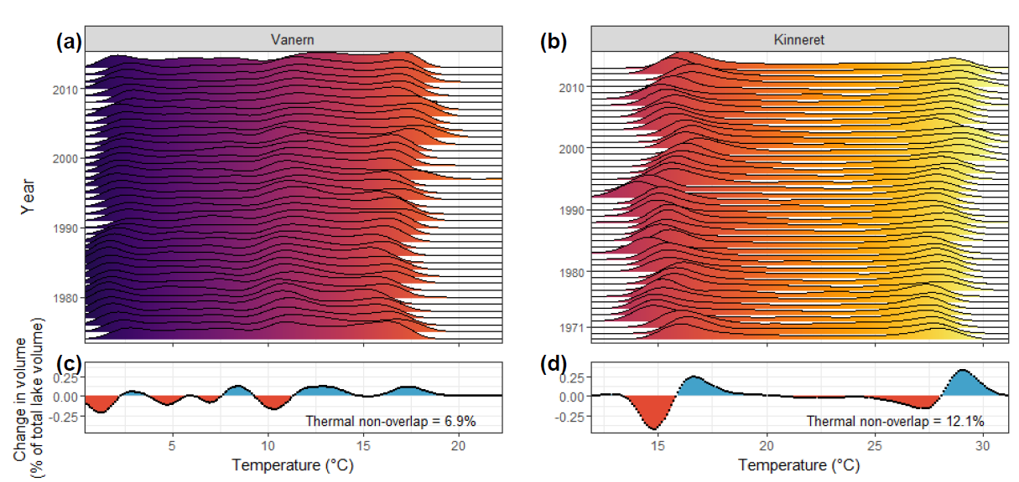
Change in volume of thermal habitat
1978-1995 versus 1996-2013
Sweden
Israel
Kraemer et al., in press

Slide 7
Adapt, move, or die…
Metabolism
Seasonality
Development
Location
Morphology
Interactions
Extinction
Benjamin Kraemer
Notes:
So to start chipping away at this uncertainty, here we investigate two of these potential responses.
Warming may require some lake organisms to shift their phenologies or their depth distributions to track their thermal habitat as lakes warm.

Slide 8
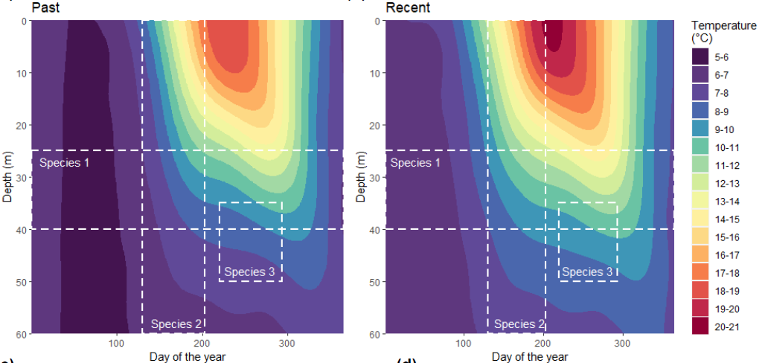
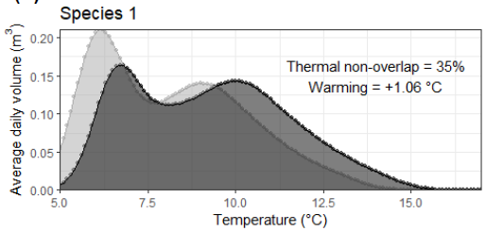
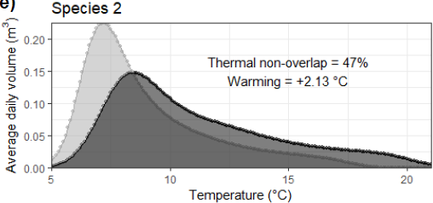
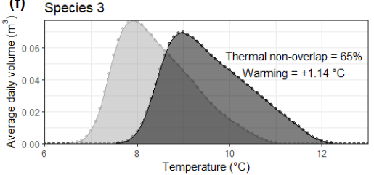
Change in thermal habitat for three model species
Past (baseline)
Recent (+1.14°C)
1
1
3
3
2
2
Spec1: one depth
Spec 2: one season
Spec 3: one depth one season
Kraemer et al., in press

Slide 9
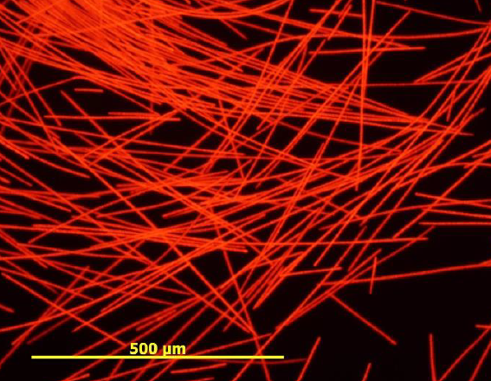
Thermal habitat change Planktothrix rubescens
(Lake Zürich)
Photo credit: Thomas Posch
Kraemer et al., in press

Slide 10
Thermal habitat changes in 139 lakes globally
1978–1995 versus 1996-2013
Average: 6 % non-overlap
Restricted by season and depth:
19 % non-overlap
Kraemer et al., in press
Notes:
Projections of intermittent ice cover
Dark blue: 14800 lakes that are currently estimated to experience intermittent winter ice cover
Light blue: Lakes forecasted to experience intermittent winter ice – with an air temp increase of 1.5°C
Dark green: Lakes forecasted to experience intermittent winter ice – with an air temp increase of 3.2°C
Light green: Lakes forecasted to experience intermittent winter ice – with an air temp increase of4.5 °C
Very low resistance- but high resilience?
Internal reinforcement of a state?

Slide 11
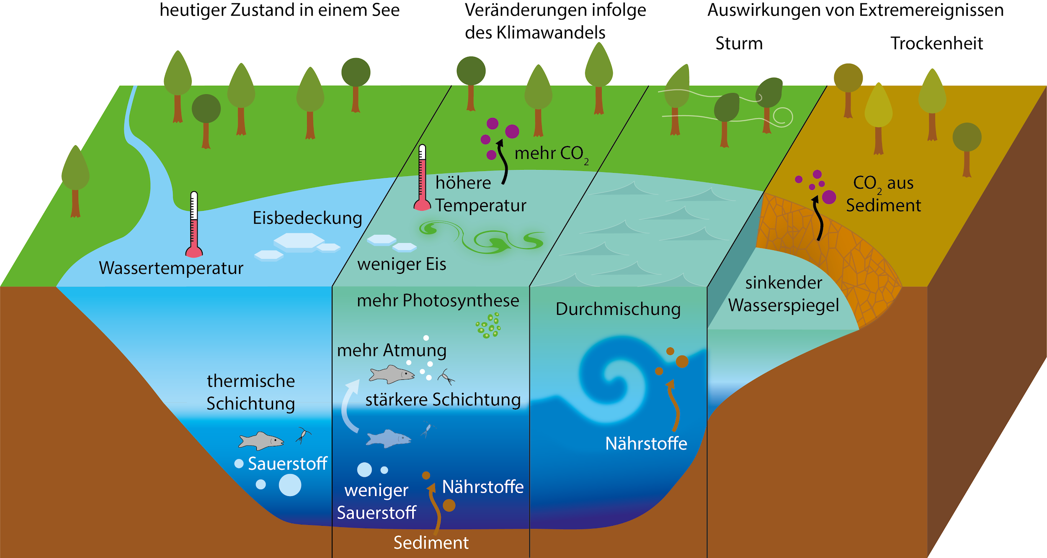
Climate change and Freshwater /
feedsbacks to the climate
Early / current state
CC affected state
Impact of extremes
Storms Droughts
Adrian & Kraemer 2020

Slide 12
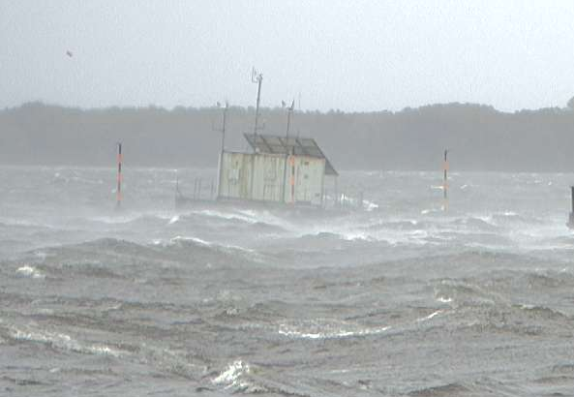
Orcan XAVIER at Lake Müggelsee
Turbidity [NTU]
Wind speed [m/s]
Turbidity
October 5th. 2017

Slide 13
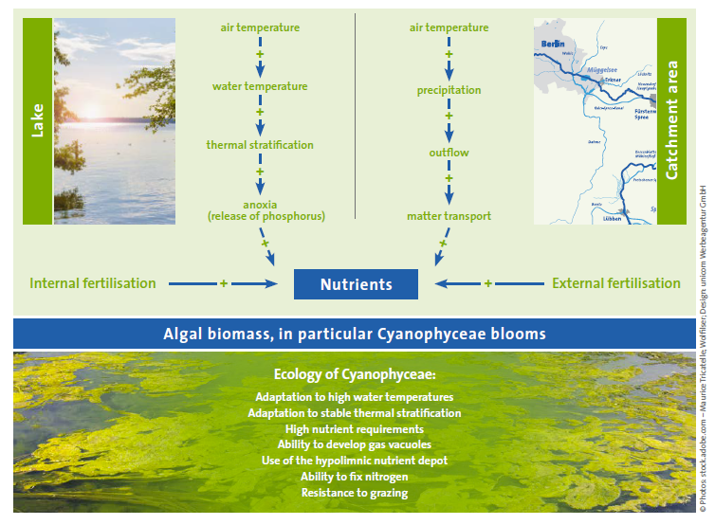
Ecological consequences
Adrian & Shatwell 2018

